Slide 1

“No show to appointment” project
Presented by: Gaukhar Makhmetova
DSC 789-001: Strategic Capstone Project
Professor: Zahra Sedighi Maman

Slide 2

Outline
Motivation
Data Overview
Data Exploratory Analysis
Data Preparation
Modelling
Final Methodology Framework
Suggestions
Future research recommendations

Slide 3
Motivation
Patient No-Show
Inefficient Allocation of Resources
Limited Access to Care
Poor health Outcomes
High Healthcare Costs
Dissatisfaction with long lead time
A person makes a doctor appointment, receives all the instructions and no-show. Who to blame?
Patient no-show is a prevalent problem in health care services.

Slide 4
Goal
Patient interventions are attempted to reduce no-show rates, with phone calls, short message service (SMS) texts, and emails being particularly impactful. However, in spite of all these initiatives, the no-show rates cited for USA ranged from 5% to as high as 55%
The goal for this project is to determine what factors are important for predicting is a patient will show up for their scheduled appointment.

Slide 5
Previous Related Studies
Lenzi, Ben, Stein
Naïve and Mixed-effect logistic regression
Young age and previous patient non-attendance have been consistently reported
Ferro, Brailsford, Braco, Smith
A Machine learning-based DSS is used to predict no-show probability in healthcare.
Patient Classification – Key element to improve performance
Dantas, Hamacher, Oliviera, et all
Logistic regression analyses, predictive models for each medical specialty
Factors that influenced No-Shows: appointment in the later hours of the day, appointments not in the summer months, post-surgery appointment, high leadtime, higher no-show history
An association has also been found between longer lead time (the time between the scheduling and the appointment) and higher no-show rates

Slide 6
Data Overview
Variable | Definition
PatientId | Patient ID
AppointmentID | Appointment ID for patient
Age | Patient age
Gender | Patient sex
Month | Month of the appointment
AppointmentDay | Day of the appointment
Waiting_time..minute. | Time hospital waited for patient
Calling.time..hour.in.a.day. | The hour of calling to schedule an appointment
SMS_received | Status of receiving reminder message or call
Alcoholism | Status of being an alcoholic
Financial_aid | Status of having a financial support
Handicap | Status of being handicap
Hypertension | Status of having high blood pressure
Diabetes | Status of being diabetic
time_b_appointment..day. | Number of days between two consecutive scheduled appointments
Show.up | yes – showed up, no – no-show
The dataset represents healthcare information collected in Espirito Santo, Brazil. The dataset that was downloaded from Kaggle (https://www.kaggle.com) contains 72,607 cases observations and 16 variables in total (refer to the table below.

Slide 7
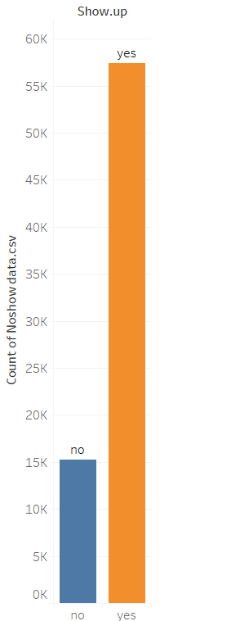
Methodology
Data Exploration Analysis in Tableau
Visualizing all variables regarding target value
Recognition problems in dataset
Unnecessary data
Imbalanced dataset
Outliers

Slide 8
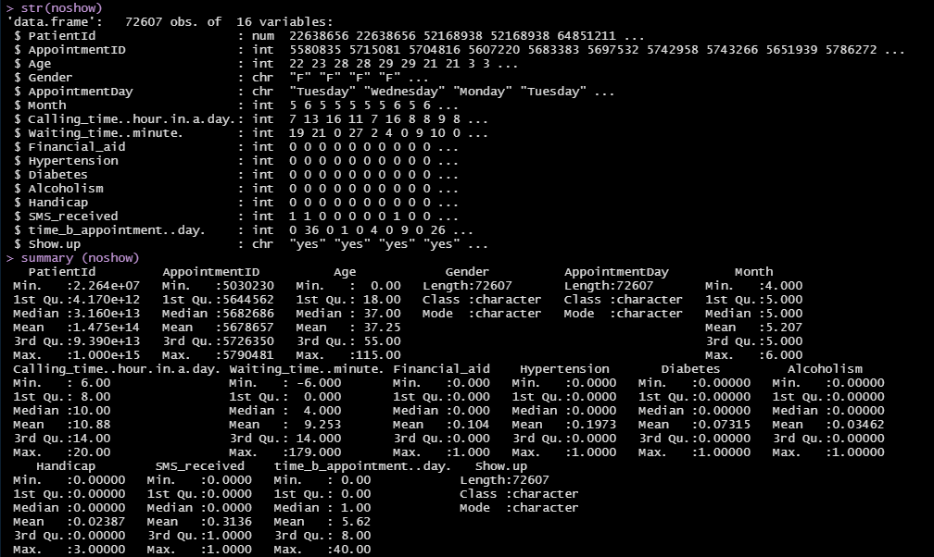
Rstudio
Import data
Data overview

Slide 9
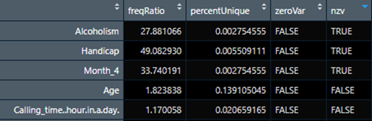
Data Preparation
Onehot Encoding of Categorical variables.
AppointmentDay, Month Gender and Show.up
Deleting created columns to avoid redundancy
Gender_M, Show.up_no
Deleting irrelevant variables
PatientId, AppointmentID
Identifying Near Zero Variance predictors
Deleting AppointmentDay_Saturday
Handicap
Alcoholism

Slide 10
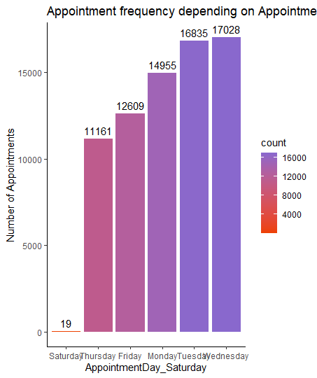
Near Zero Variance
Alcoholism

Slide 11
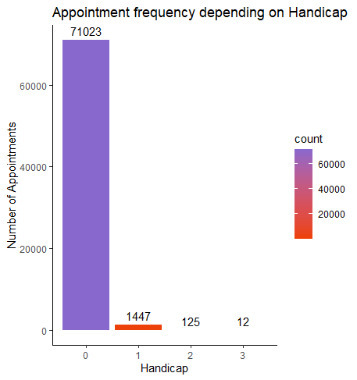
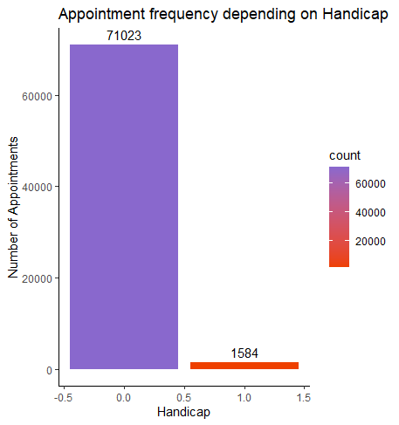
Near Zero Variance
Handicap

Slide 12
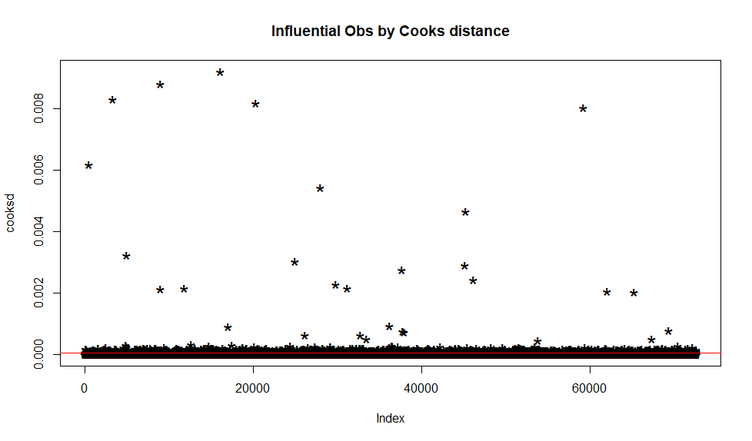
Cook’s Method

Slide 13
Detecting and Deleting Outliers
Devide AppointmentDay into Levels from 1 to 6
Model | Sensitivity | Specificity | Precision | Gmean | Accuracy | AUC
GLM_before_Cook’s | 0.018 | 0.990 | 0.326 | 0.135 | 0.79 | 0.562
GLM_after_Cooks | 0.020891 | 0.987135 | 0.305 | 0.144 | 0.781 | 0.547
Dummy variables were created for AppointmentDay
Model | Sensitivity | Specificity | Precision | Gmean | Accuracy | AUC
GLM_before_Cook’s | 0.022 | 0.98 | 0.368 | 0.15 | 0.783 | 0.57
GLM_after_Cooks | 0.040 | 0.985 | 0.305 | 0.2 | 0.781 | 0.6

Slide 14
Splitting Data into Train and Test
Model | Train/test split | Sensitivity | Specificity | Precision | Gmean | Accuracy | AUC
GLM | Balanced Split | 0.040 | 0.985 | 0.305 | 0.2 | 0.781 | 0.6
GLM | K-fold cross-validation | 0.043 | 0.983 | 0.351 | 0.2 | 0.821 | 0.6

Slide 15
Enforcement Balancing Methods Comparison
Model | Train/test split | Balance | Sensitivity | Specificity | Precision | Gmean | Accuracy | AUC
GLM | K-fold cross-validation | DBSMOTE | 0.575 | 0.691 | 0.282 | 0.631 | 0.671 | 0.583
GLM | Balanced Split | DBSMOTE | 0.591 | 0.683 | 0.277 | 0.635 | 0.668 | 0.584
Model | Balance | Sensitivity | Specificity | Precision | Gmean | Accuracy | AUC
GLM | DBSMOTE | 0.591 | 0.683 | 0.277 | 0.635 | 0.668 | 0.584
GLM | ADASYN | 0.6832 | 0.6818 | 0.311 | 0.682 | 0.682 | 0.6111
GLM | BLSMOTE | 0.222 | 0.9199 | 0.368 | 0.4519 | 0.798 | 0.608

Slide 16
Feature Selection
Model | Feature Selection | Sensitivity | Specificity | Precision | Gmean | Accuracy | AUC
GLM | Importance | 0.572 | 0.695 | 0.288 | 0.631 | 0.673 | 0.585
GLM | Lasso | 0.598 | 0.683 | 0.279 | 0.6287 | 0.668 | 0.586
GLM | Importance+Lasso | 0.568 | 0.692 | 0.277 | 0.635 | 0.673 | 0.586
GLM | Elastic Net | 0.569 | 0.694 | 0.282 | 0.628 | 0.673 | 0.583

Slide 17
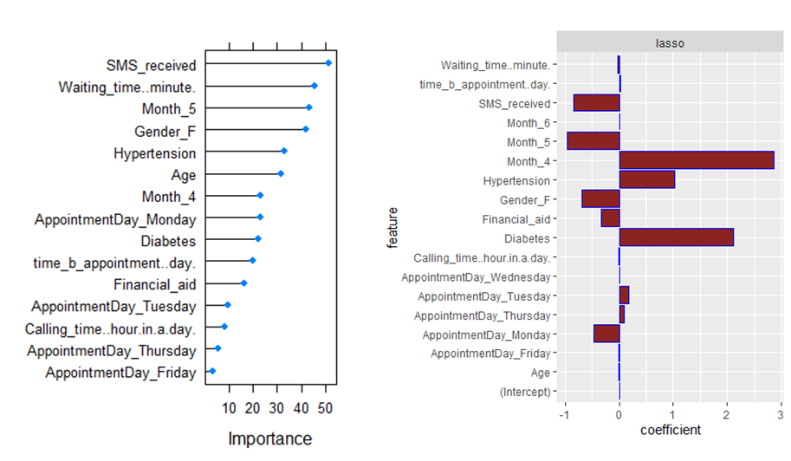
Near Zero Variance Predictors and Feature Selection
Alcoholism and Handicap Present
Alcoholism and Handicap absent

Slide 18
Feature Selection
After feature selection following features were deleted from the dataset:
AppointmentDay_Thursday, AppointmentDay_Friday, AppointmentDay_Wednesday, Calling_time..hour.in.a.day., Age, Month_6.
Results of the model with and without Handicap and Alcoholism
Model | Handicap+ Alcoholism | Sensitivity | Specificity | Precision | Gmean | Accuracy | AUC
GLM | yes | 0.568 | 0.692 | 0.277 | 0.635 | 0.673 | 0.586
GLM | no | 0.578 | 0.694 | 0.284 | 0.633 | 0.674 | 0.5857
Model | Removed variables | Sensitivity | Specificity | Precision | Gmean | Accuracy | AUC
GLM | no | 0.568 | 0.692 | 0.277 | 0.635 | 0.673 | 0.586
GLM | yes | 0.556 | 0.720 | 0.295 | 0.633 | 0.698 | 0.59

Slide 19
Final Model
Model | Sensitivity | Specificity | Precision | Gmean | Accuracy | AUC
GLM | 0.568 | 0.692 | 0.277 | 0.635 | 0.673 | 0.586
Random Forest | 0.106 | 0.958 | 0.835 | 0.319 | 0.810 | 0.594
Decision Tree | 0.317 | 0.894 | 0.894 | 0.532 | 0.707 | 0.606

Slide 20
Final Model After Tuning
Model | Balancing Method | Sensitivity | Specificity | Precision | Gmean | Accuracy | AUC
GLM | DBSMOTE | 0.568 | 0.692 | 0.277 | 0.635 | 0.673 | 0.586
Random Forest | DBSMOTE | 0.508 | 0.774 | 0.514 | 0.627 | 0.728 | 0.6019
Decision Tree | DBSMOTE | 0.317 | 0.894 | 0.894 | 0.532 | 0.708 | 0.606
GLM | ADASYN | 0.6516 | 0.7279 | 0.335 | 0.6886 | 0.7146 | 0.621
Random Forest | ADASYN | 0.643 | 0.692 | 0.9021 | 0.665 | 0.684 | 0.604
Decision Tree | ADASYN | 0.301 | 0.904 | 0.904 | 0.5218 | 0.674 | 0.603
Model | Elapsed (real time)
GLM | 0.99
Random Forest | 56.42

Slide 21
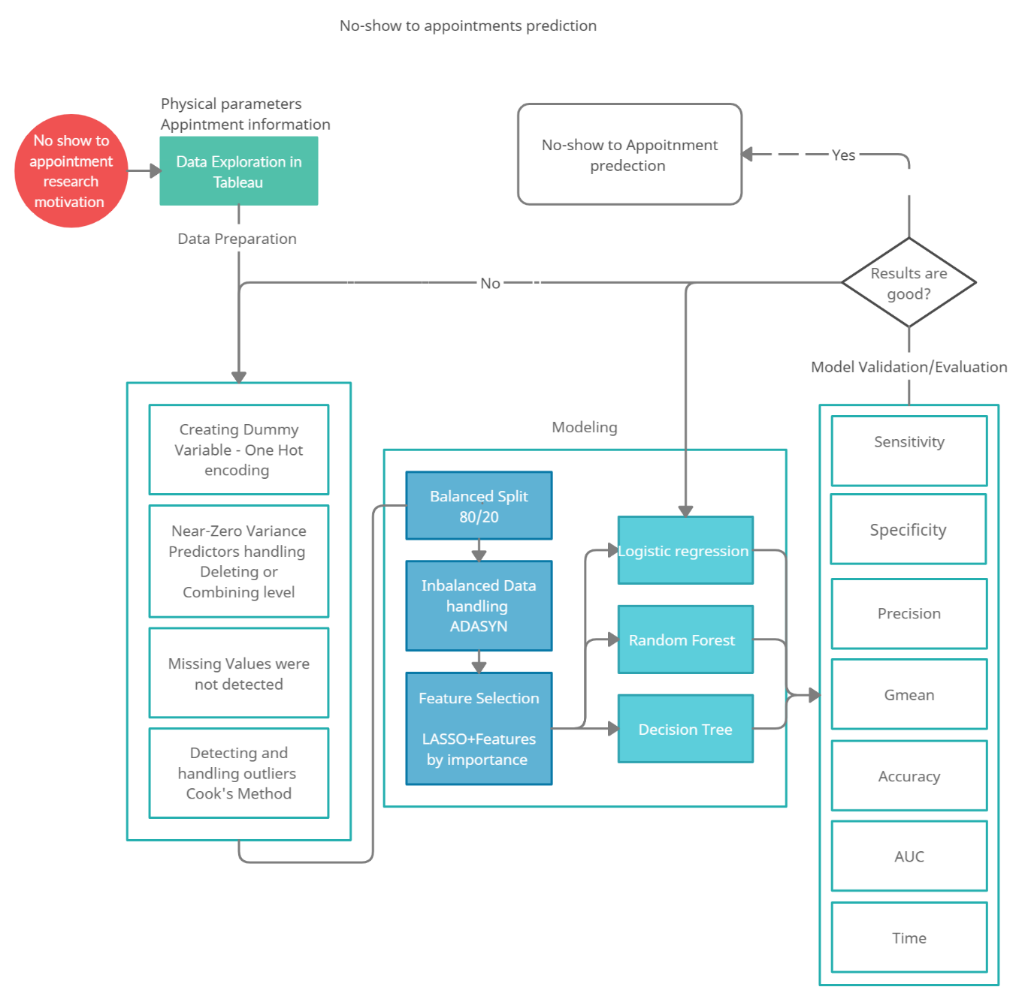
Methodology Framework

Slide 22

Suggestions
Investment
- Automated service for notifications with option to cancel
- Extra labor force hire for reminder calls
Policies
- Monetary penalty for late show up and no-show up cases

Slide 23
Recommendations for future research
Absence of variables of high importance in dataset
Date of Confirming an Appointment
Date of Actual Appointment
Neighborhood
Model advancement
Enhancing Decision tree by tuning parameters
Applying other models
Take into account the time wasted while waiting for patients for those who show up

Slide 24
References
Ferro, D. B., Brailsford, S., Bravo, C., & Smith, H. (2020). Improving healthcare access management by predicting patient no-show behaviour. Decision Support Systems, 138, 113398.
Lenzi, H., Ben, Â. J., & Stein, A. T. (2019). Development and validation of a patient no-show predictive model at a primary care setting in Southern Brazil. Plos one, 14(4), e0214869.
Dantas, L. F., Hamacher, S., Oliveira, F. L. C., Barbosa, S. D., & Viegas, F. (2019). Predicting patient no-show behavior: a study in a bariatric clinic. Obesity surgery, 29(1), 40-47.

